Slide 1
PYTHON PROGRAMMING
MODULE 5

Slide 2
Functions
Introduction:
If we have so many lines, we can separate those lines using FUNCTIONS.

Slide 3
Anology
Have seen chorus in a lyrics?
How chorus is written?
It is repeated after a passage, right?

Slide 4
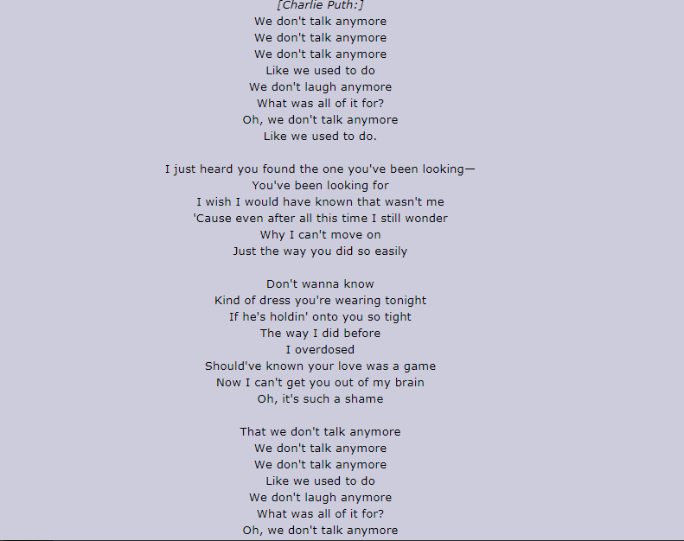

Slide 5
Let say, we want to write the lyrics again
in Python,
We don’t have to write the whole lyrics!

Slide 6
First, there is a way to print a passage without repeated ‘print’ syntax

Slide 7
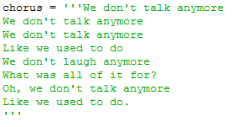
example
1st step: Assign a passage into a variable

Slide 8
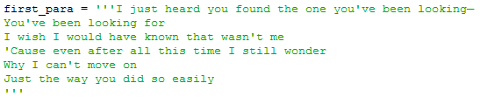
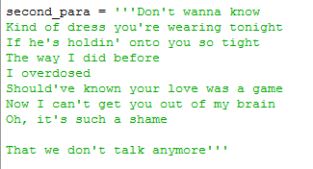
Example

Slide 9
But they are too long!!!
So, what we gonna do is…
We separate them into a block called FUNCTION

Slide 10

Define function
Next step: Define a function like this and print all variables

Slide 11

Call Function
Last step: Call the function by writing the function name.
Otherwise, the passages will not be displayed in output.

Slide 12
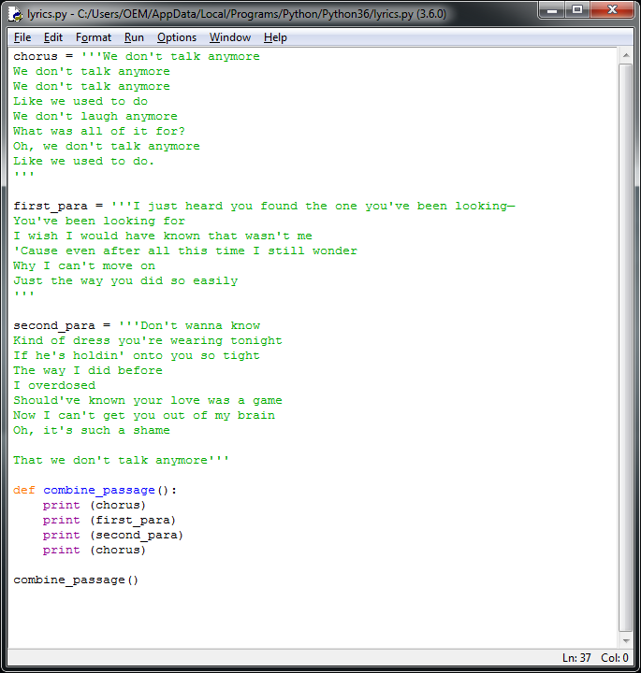
Full Codes

Slide 13
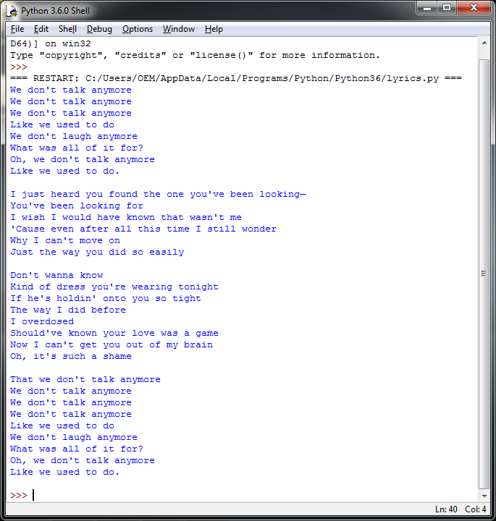
Output

Slide 14
Challenge # 1
Edit the codes, so that the lyrics will be written in a textfile

